Slide 1
Day 1: Introducing RStudio
By Miranda McKibben

Slide 2



A little about me: My education
I graduated from Olentangy Orange High School and the Delaware Area Career Center Zoo School program in 2018.
I got a B.S. in Biology, specializing in Ecology and Evolution, from the University of Chicago in 2022.
I am a third year PhD student at the University of Georgia.

Slide 3
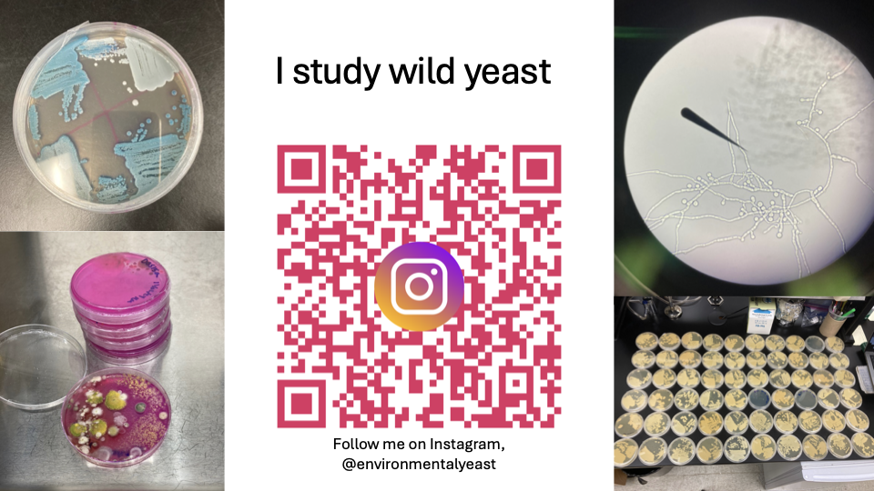

Slide 4
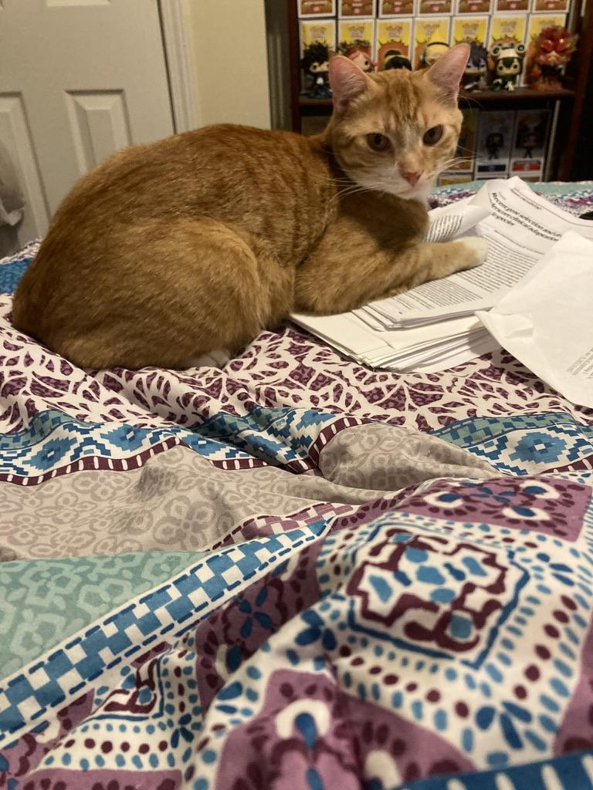

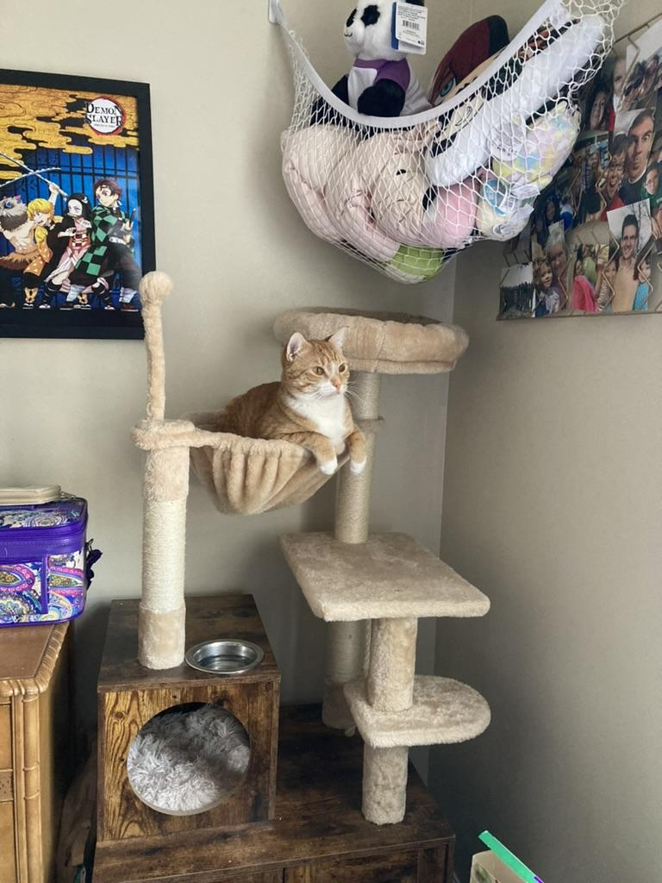

My interests outside academia: Spelunking and cuddling my cat, Toki Roki.

Slide 5
By the end of this course you will:
Develop computational thinking skills
Create RStudio code to analyze datasets
Dissect scientific papers
Formulate hypotheses
Defend your coding choices

Slide 6
Question
What are some reasons to write code to analyze data?

Slide 7
Possible Answers
Forces you to think about how you are analyzing the dataset
What questions are you trying to answer?
Are you performing the right tests/creating the right figures, or do the tests and figures you chose produce a biased result?
Reproducibility: By writing your own code, you will know exactly what you did to the dataset later. This allows you to apply the code to other datasets with the exact same type of analysis, and also gives others the opportunity to check and expand upon your work.

Slide 8
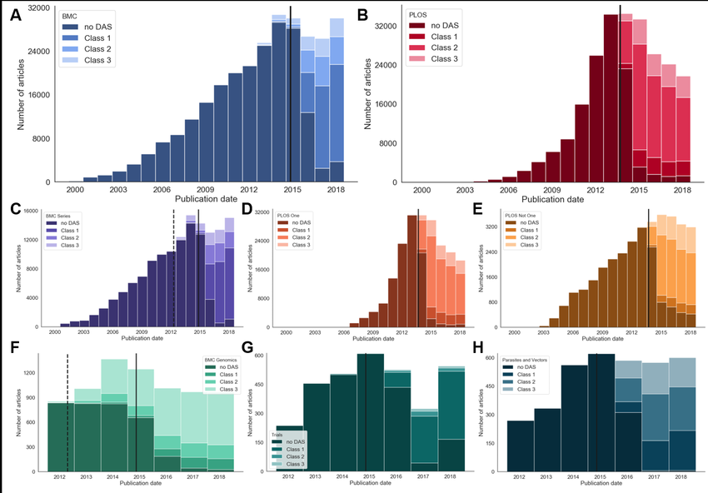
Colavizza, G., Hrynaszkiewicz, I., Staden, I., Whitaker, K., & McGillivray, B. (2020). The citation advantage of linking publications to research data. PloS one, 15(4), e0230416. https://doi.org/10.1371/journal.pone.0230416
Notes:
In 2015 many journals began to require Data Availability Statements (DAS) and accessible datasets and code used to produce figures and analysis. In this figure each plot represents a different journal. The black line shows the time that these journals began to require a DAS.

Slide 9



RStudio
A SYSTEM TO ANALYZE AND VISUALIZE DATA
FREE, OPENSOURCE SOFTWARE THAT ALLOWS FOR REPRODUCIBILITY
A SYSTEM FOR LEARNING HOW TO CODE
Notes:
RStudio is an integrated development environment (IDE). What does that mean? An IDE is meant to help you write your code. While you write your code, the IDE may suggest available options. It also has a built in system to help identify what types of errors may be stopping your code from running correctly. RStudio is a great IDE to learn coding on because not only is it free, but it is also set up to save both your code and high quality graphs and figures. There are two versions of RStudio: A browser version and a desktop version. Both versions have pros and cons. In this course we will be learning about the browser version to avoid any installation issues.

Slide 10
Desktop
Browser
Require download and installation, can be complicated depending on device.
Does not require internet connection.
Needs to be installed on any device you use, files need to be downloaded onto computer to save code.
Fast runtime.
Every time a new version is released needs to be redownloaded.
Everything is free
May be easier to upload and download data.
Can be accessed through internet, no installation required.
Does require internet access.
Creates a user profile, code is saved on the Cloud in addition to the option of downloading to device.
May lag depending on internet speed.
Has every version of RStudio.
Has a limited free version, more advanced projects and time spent coding costs money.
Has tutorials for many types of data analysis.

Slide 11
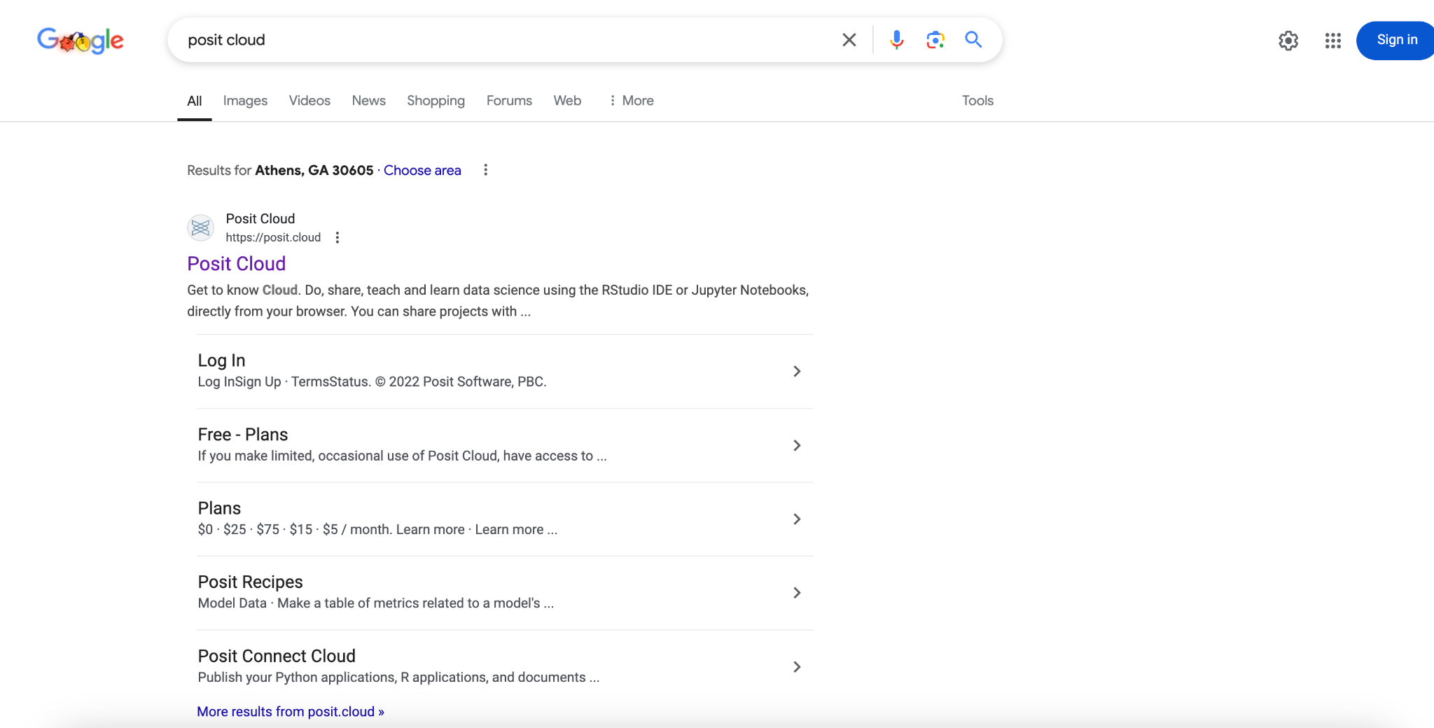
Notes:
To get started, go to your browser and search “Posit Cloud.”

Slide 12
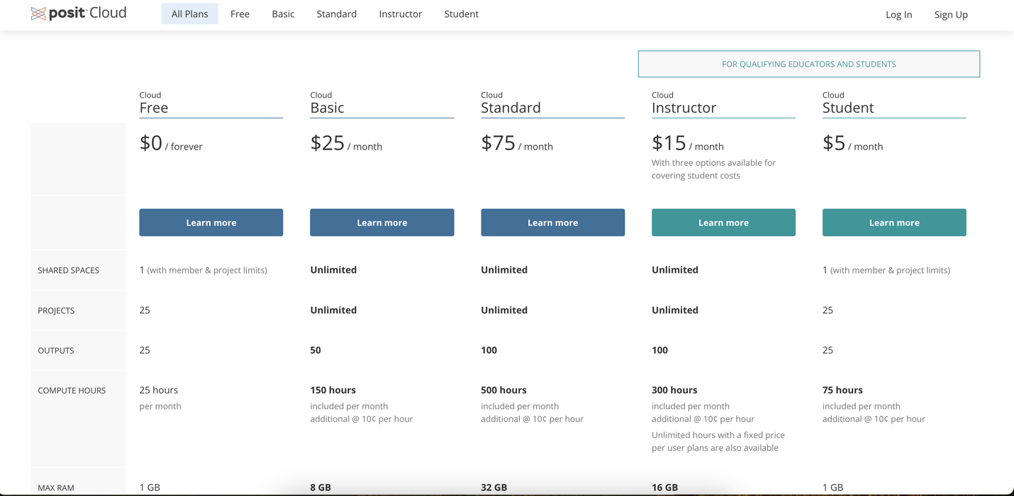
Notes:
We want to choose the Free version. When RStudio is downloaded, everything is free, so if you need to work more than 25 hours I recommend downloading the desktop version.

Slide 13
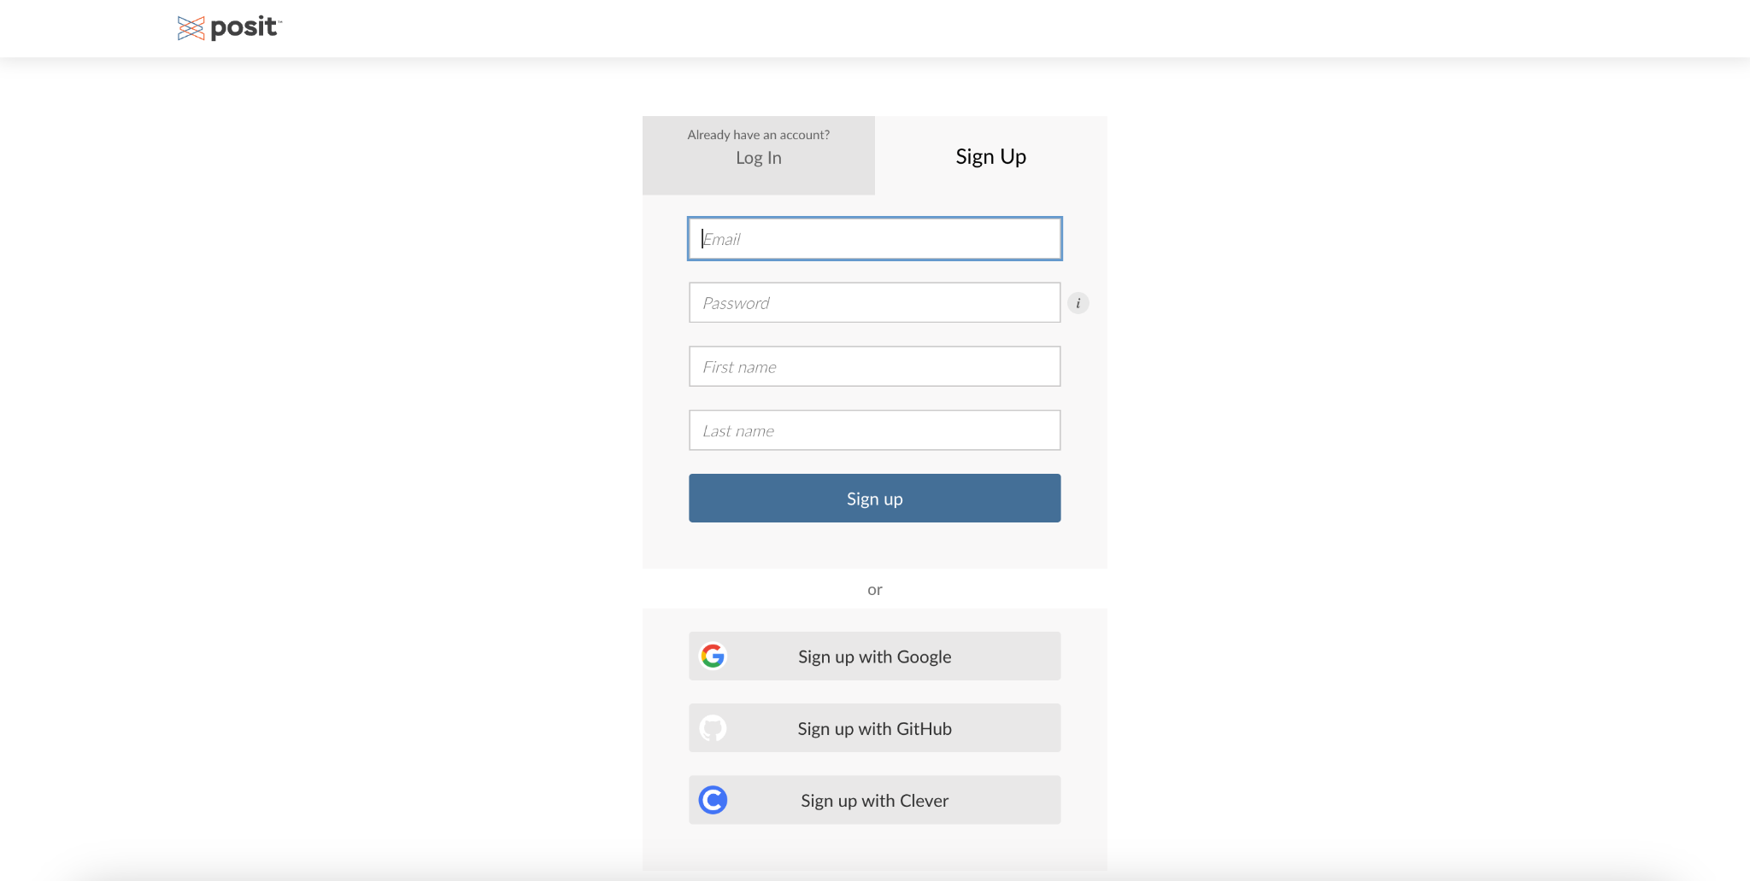
Notes:
Click “Sign up” and fill in these four boxes. You will need to verify your email address.

Slide 14
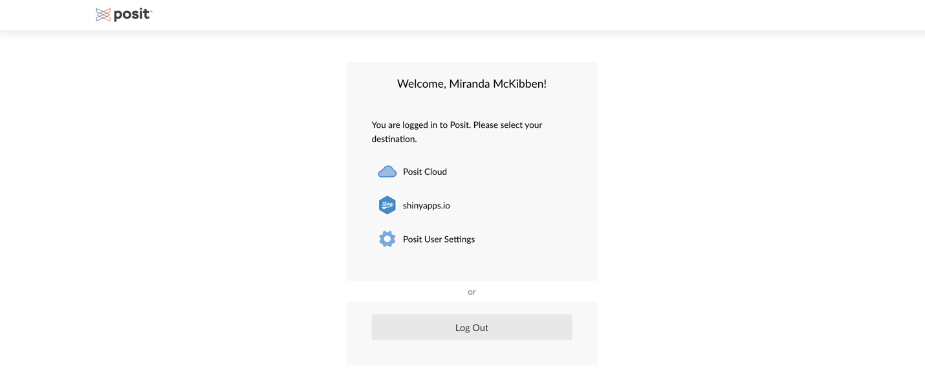
Notes:
When you login, you will get a screen like this. Select “Posit Cloud.”

Slide 15
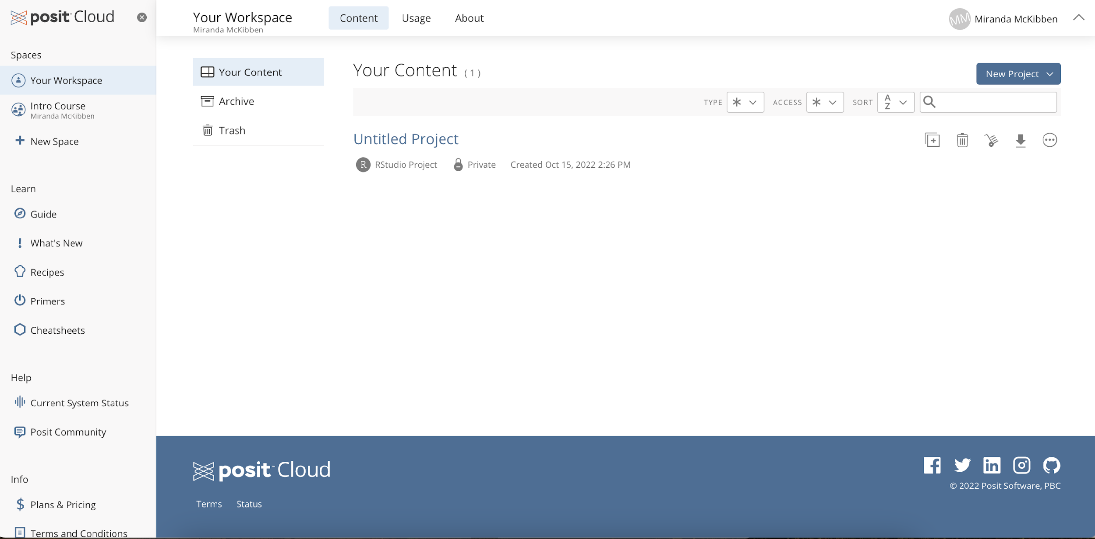
Notes:
When you login, you will get a webpage that looks like this.

Slide 16
Notes:
Notice on the side here there are some buttons to click on.

Slide 17
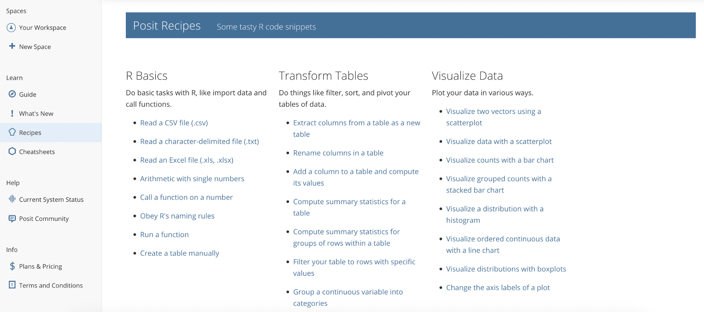
Notes:
This course will teach you the basics of RStudio, but if you want a refresher or need to do something we didn’t learn here, this is a great resource.

Slide 18
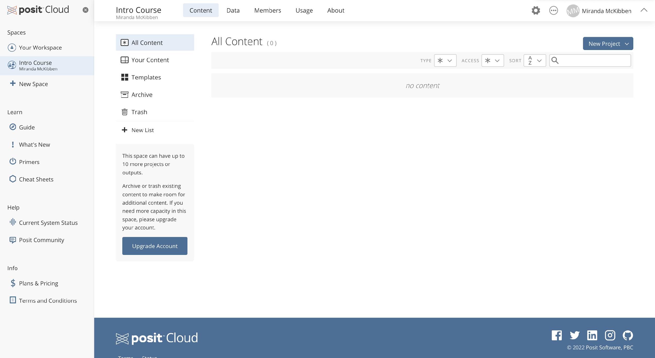
Notes:
Now to get started. On your home page, click on the button that says “New Project” in the right hand corner. Select RStudio.

Slide 19
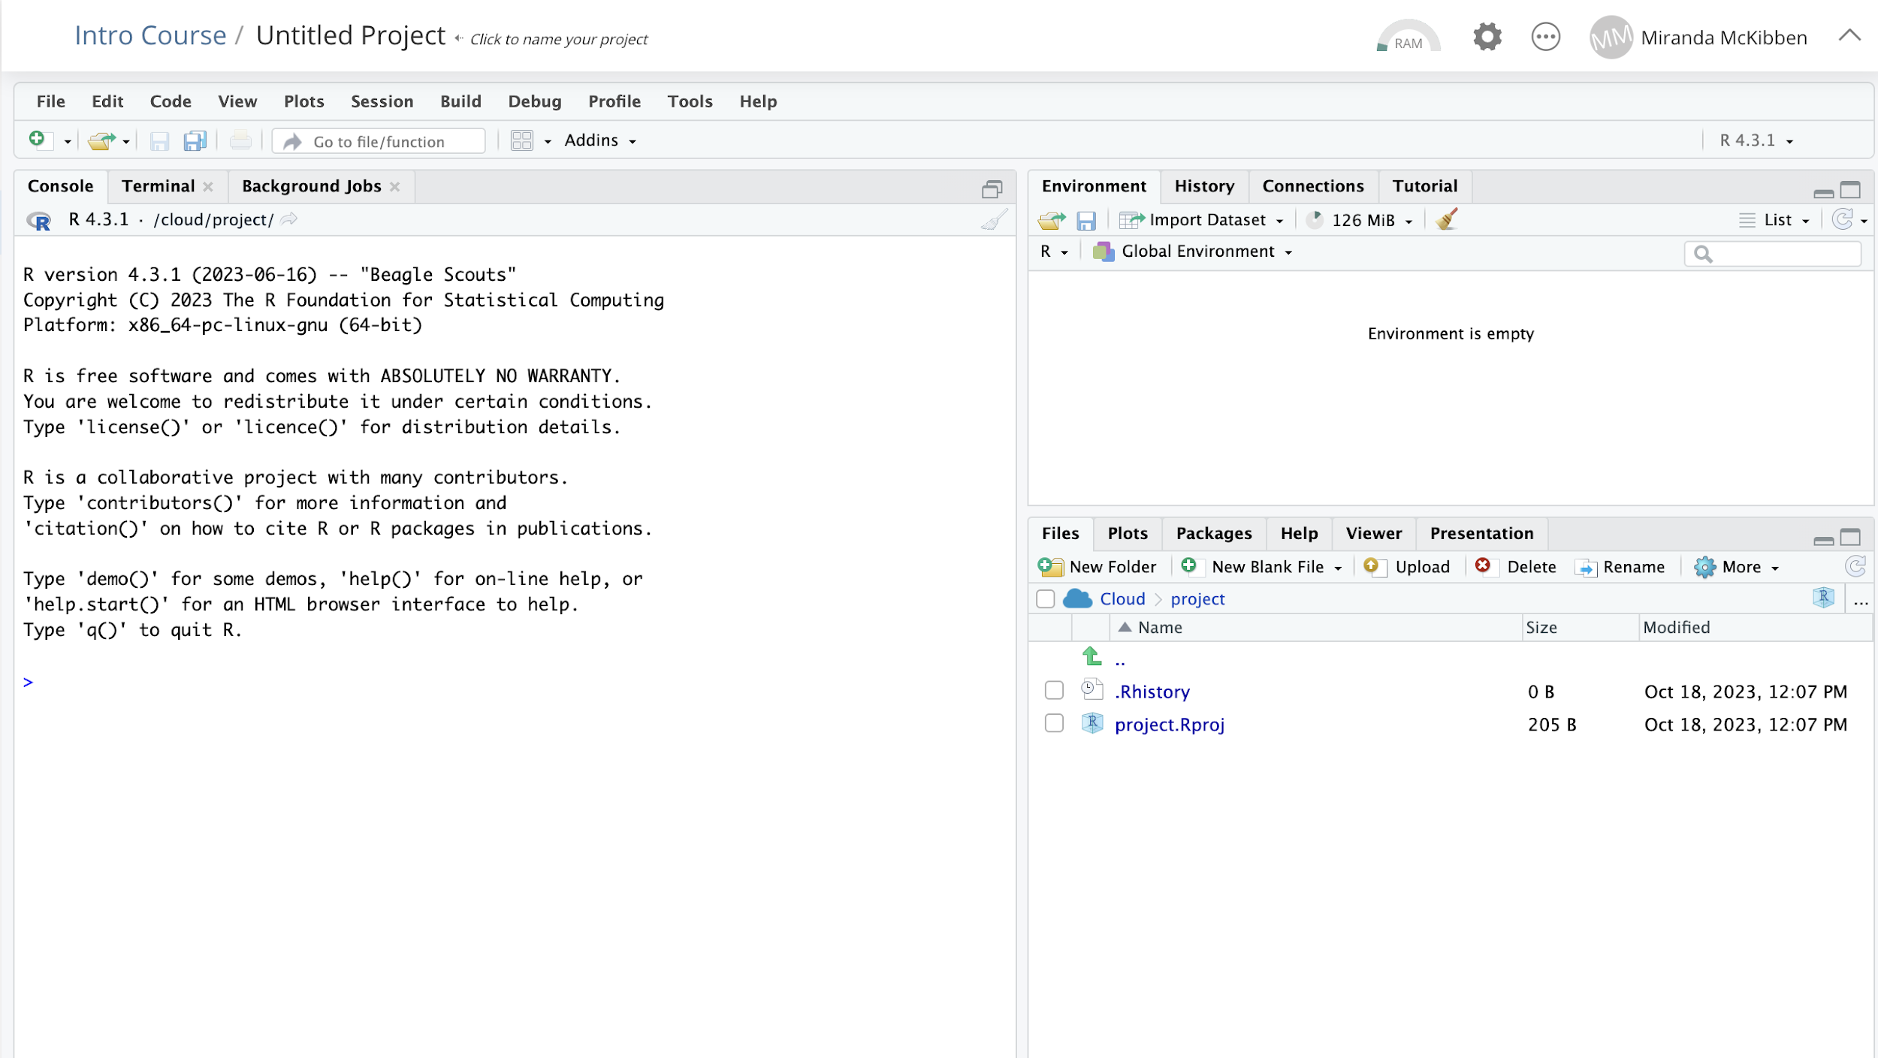
Notes:
RStudio will look like this when it opens. There are a lot of tabs, but today we will go through a basic explanation.

Slide 20
Notes:
First, click on the overlapping windows, as circled in red above.

Slide 21
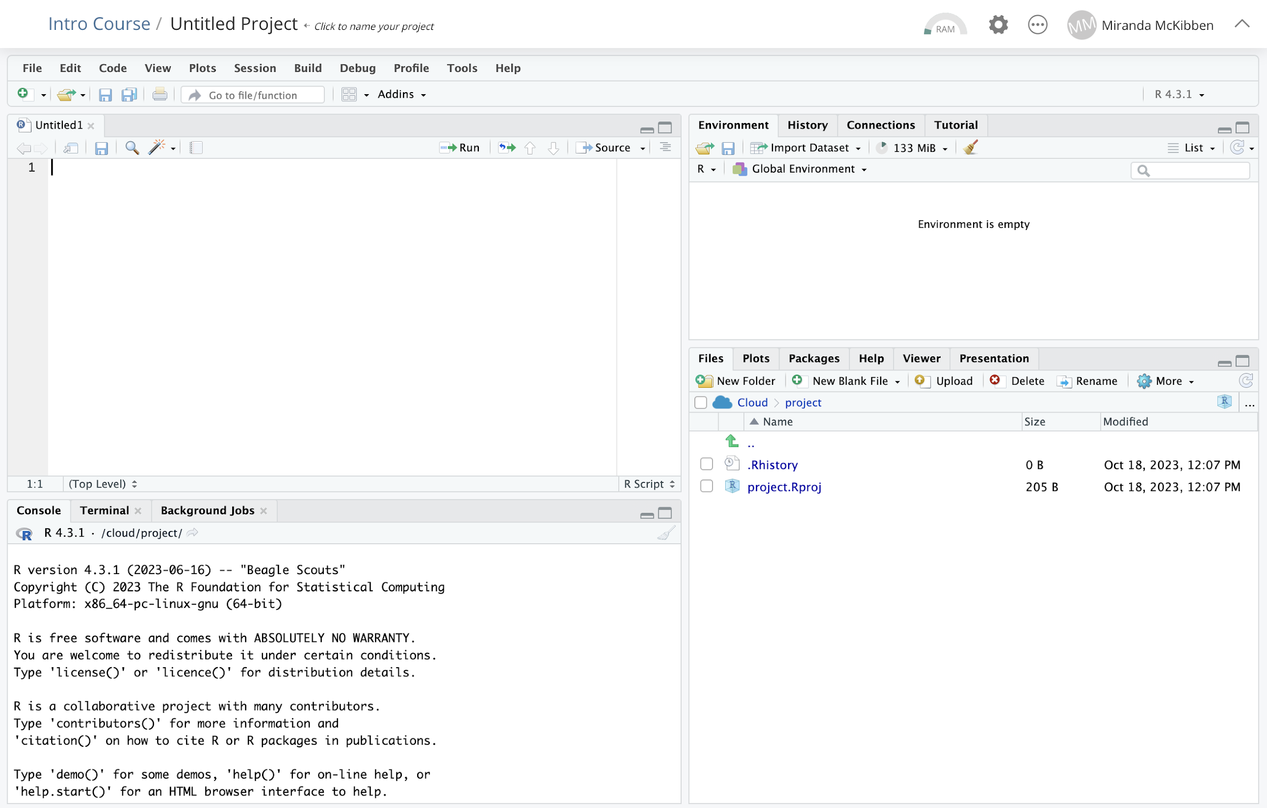
Notes:
You can see there are now four panes. Each pane has different functions in RStudio.

Slide 22
RStudio Terminology!
Source pane
Notes:
First is the source pane. This is where you will type your code to save it.

Slide 23
RStudio Terminology!
Source pane:
View and edit code in this pane.
Saves code as you type it.
Only runs code when directed.
Notes:
Code typed in the source pane is saved and can be run in chunks. This is where we will do most of our coding in our practice later today.

Slide 24
RStudio Terminology!
Environment pane
Notes:
The environment pane is in the upper right corner. This pane will show you how

Slide 25
RStudio Terminology!
Environment pane: Shows saved variables for current R session.

Slide 26
RStudio Terminology!
Console pane

Slide 27
RStudio Terminology!
Console pane: Runs code without saving it when session is closed. This pane also shows the output of code run in the source pane.

Slide 28
RStudio Terminology!
Miscellaneous pane

Slide 29
RStudio Terminology!
Miscellaneous pane: Stores generated plots, uploaded files, and information about R packages.

Slide 30
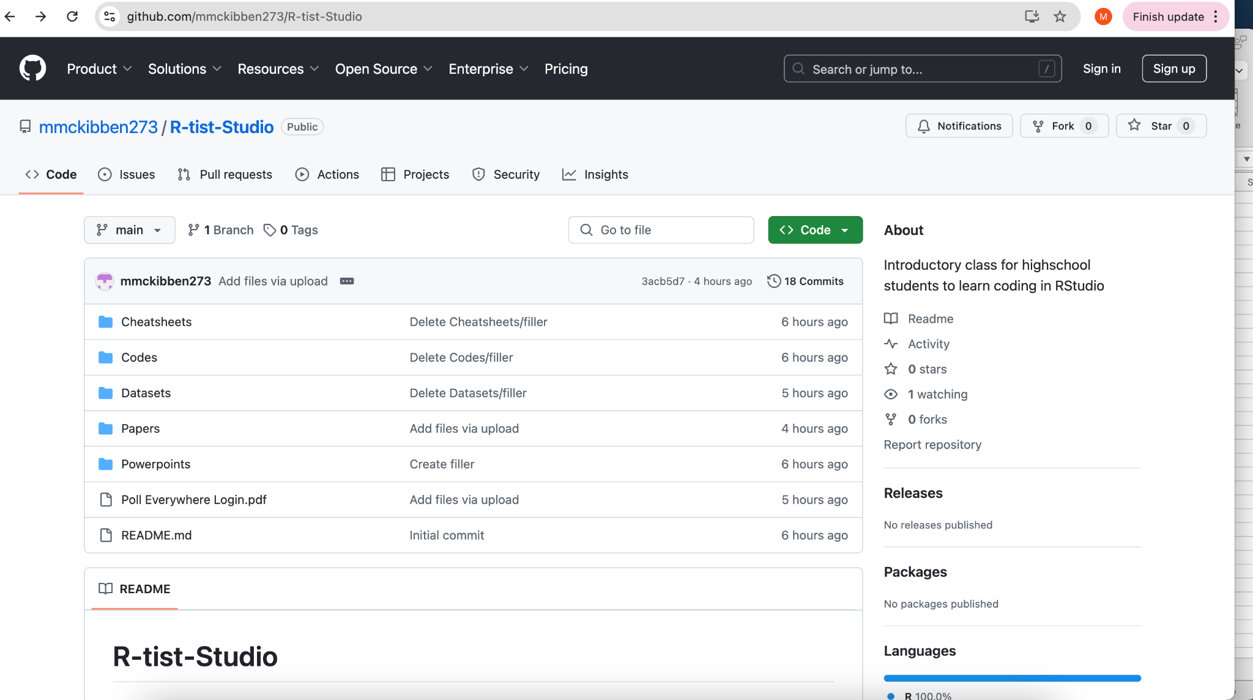
Notes:
https://github.com/mmckibben273/R-tist-Studio/tree/main

Slide 31
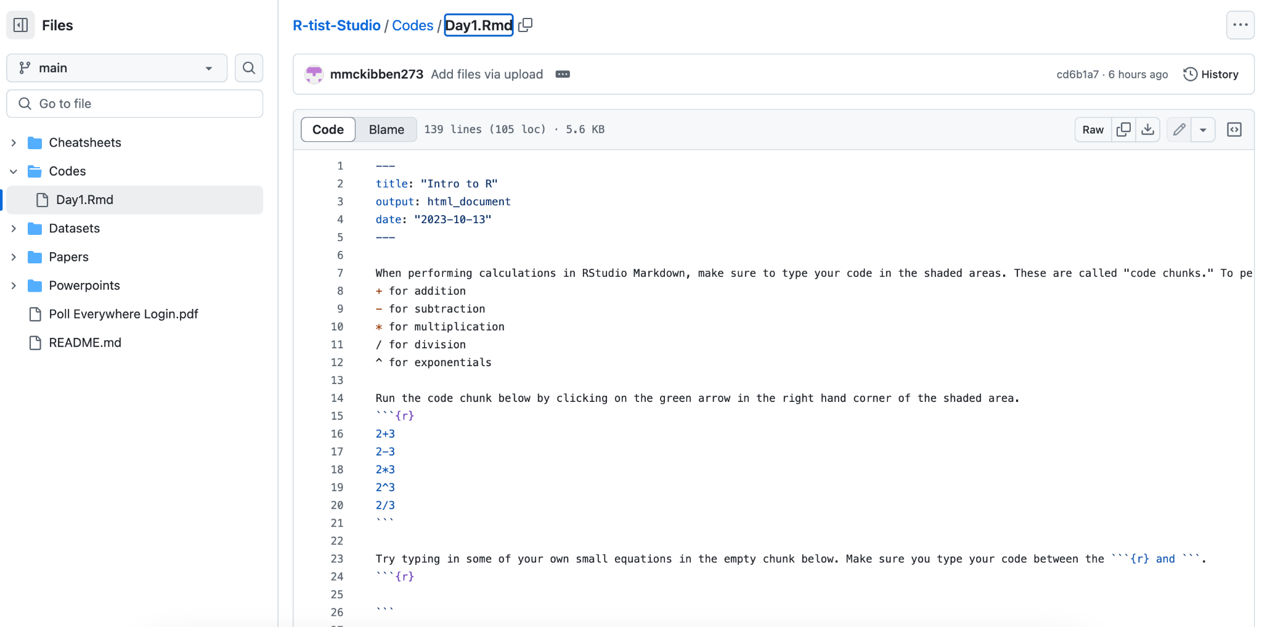

Slide 32
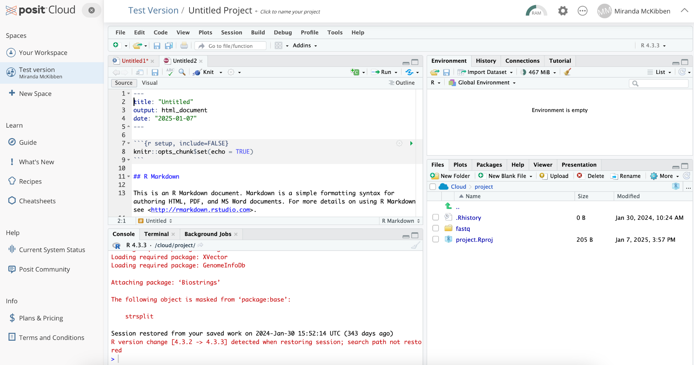

Slide 33
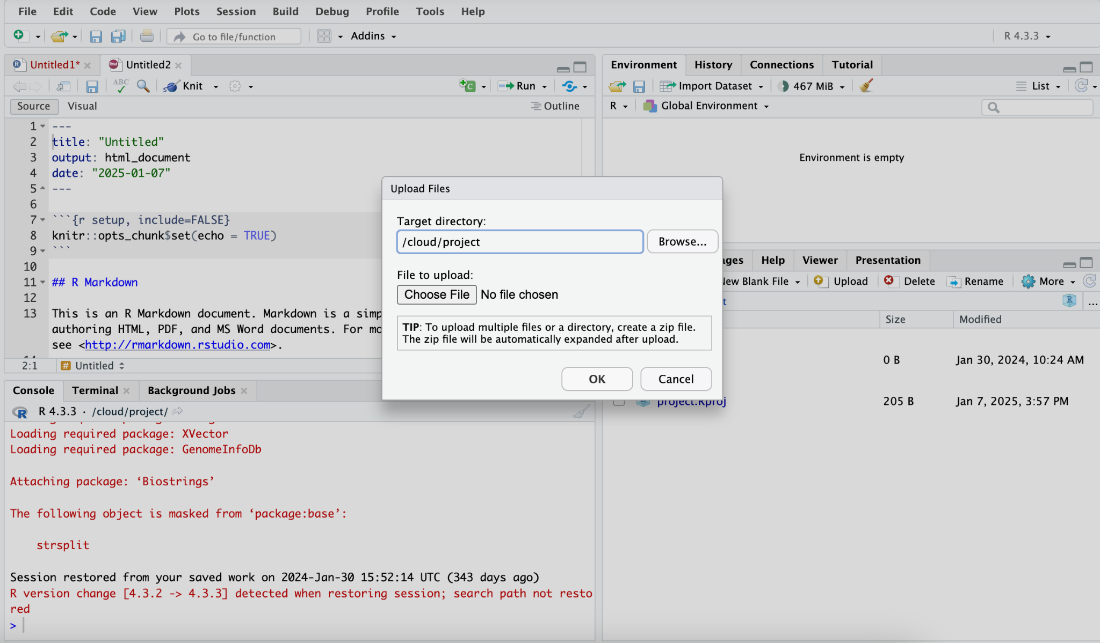

Slide 34
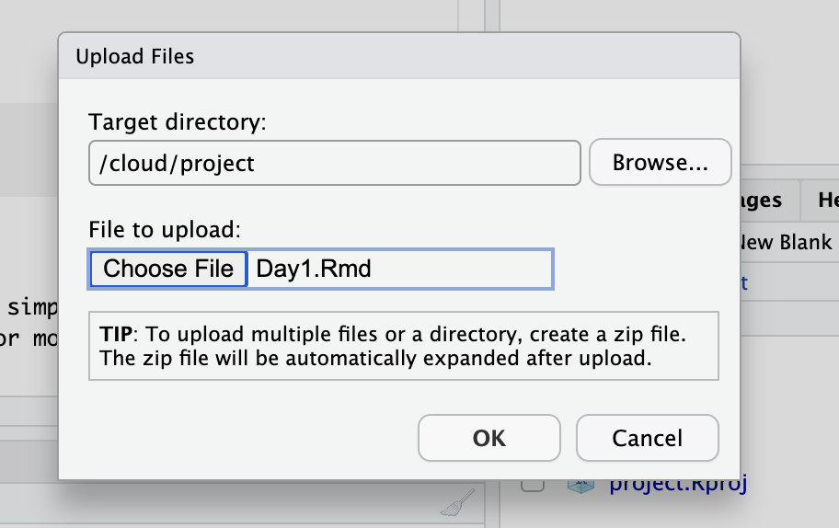

Slide 35
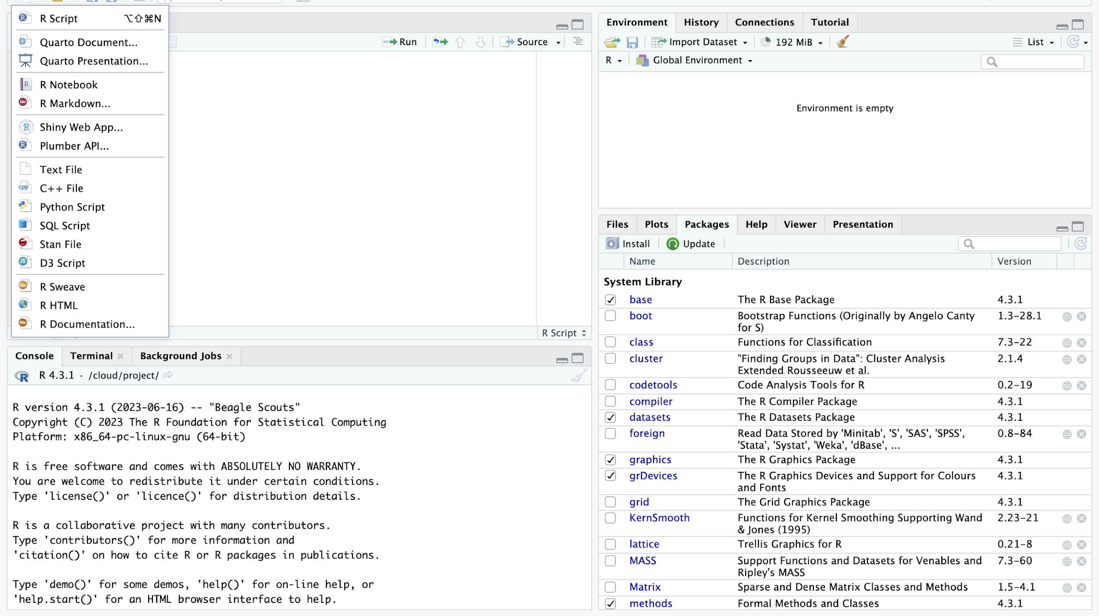

Slide 36
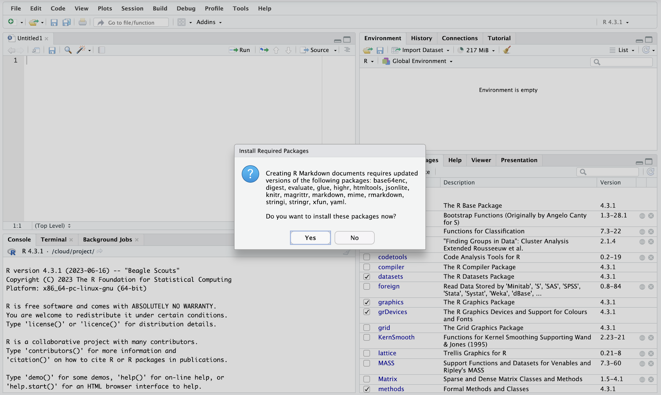

Slide 37
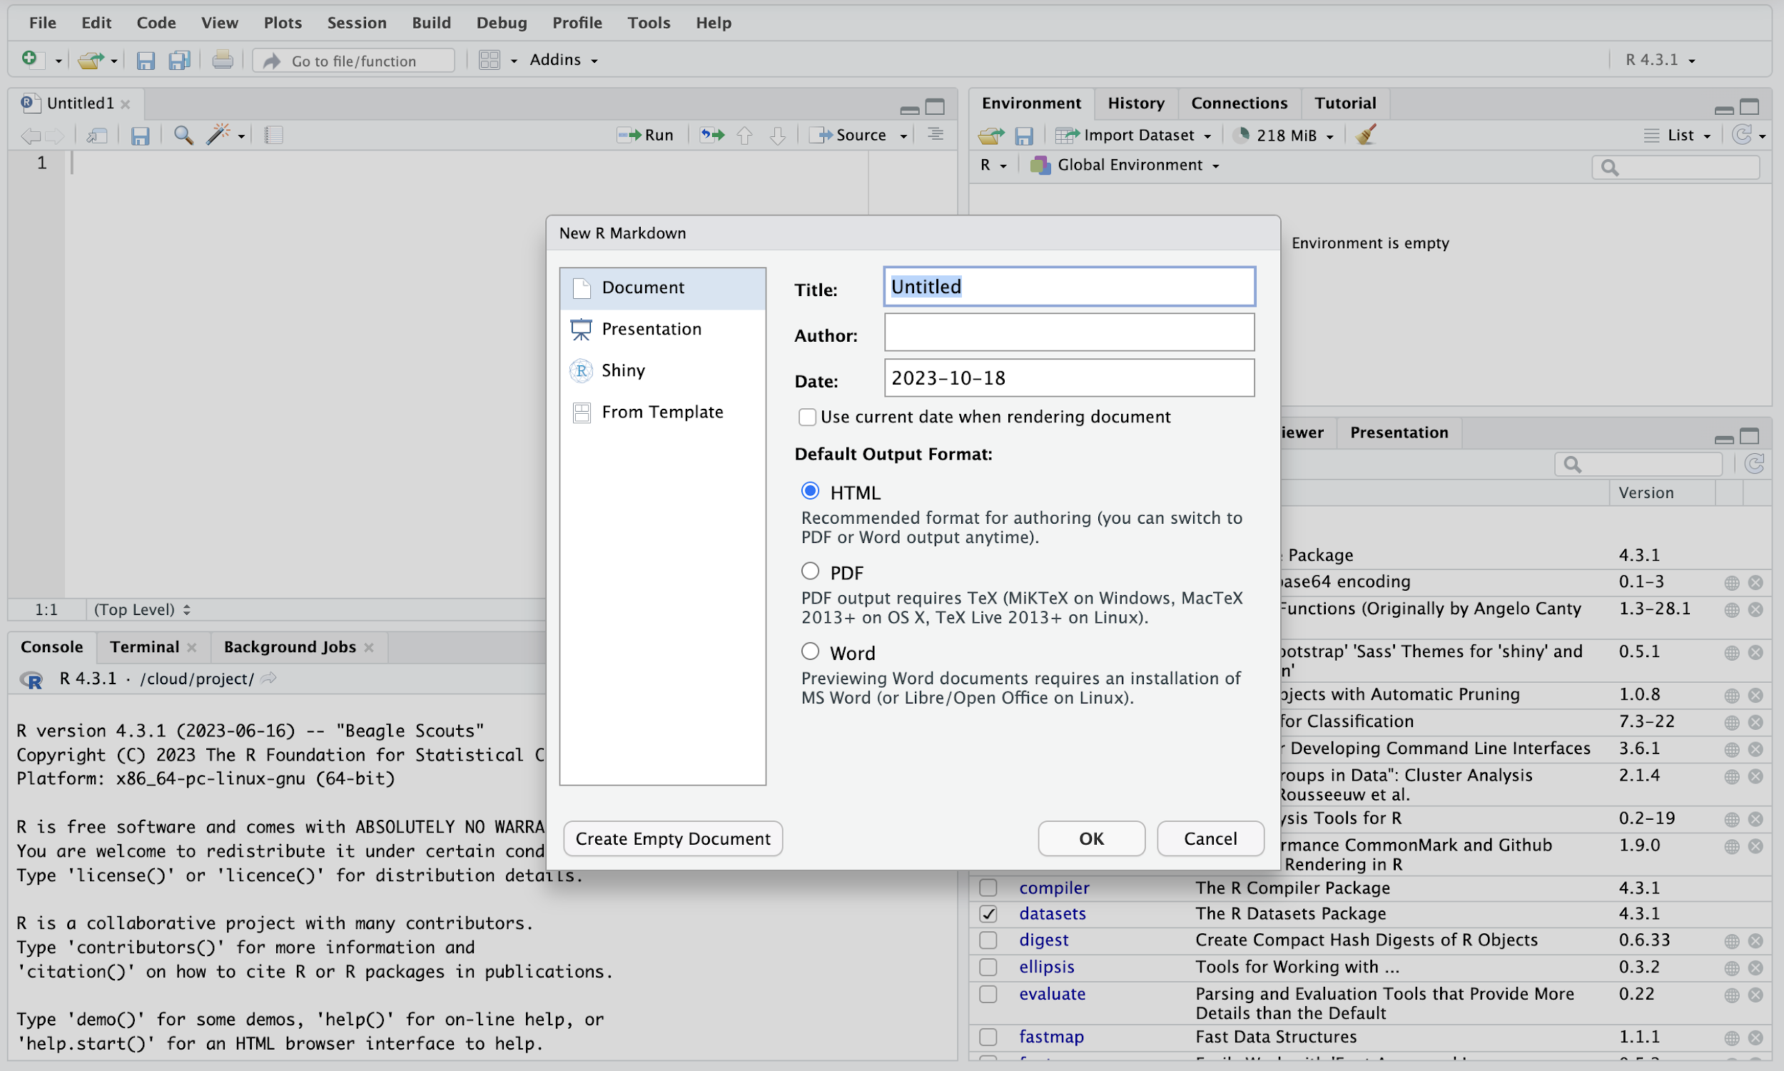

Slide 38
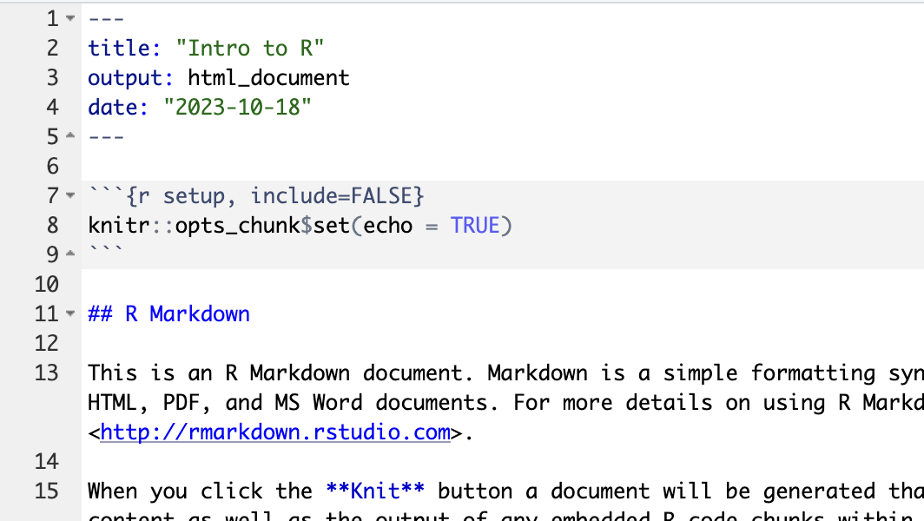

Slide 39
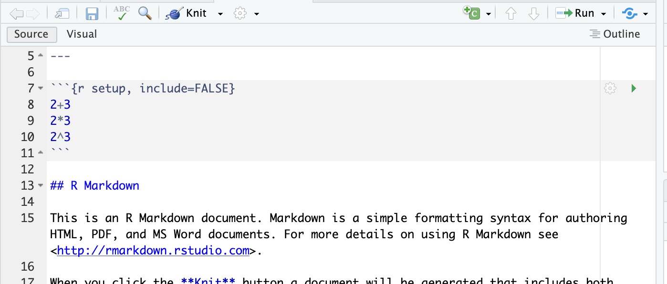
Try typing in equations:
Notes:
Addition and subtraction are straightforward: Use the plus and minus signs. For multiplication, use a star (*) between two numbers or variables. The star can be found on the number “8” key on your keyboard. To divide, use a slash (2/4=0.5). To find exponential growth of a number or variable, use the carrot (^) symbol, found on the number “6” key on your keyboard.

Slide 40
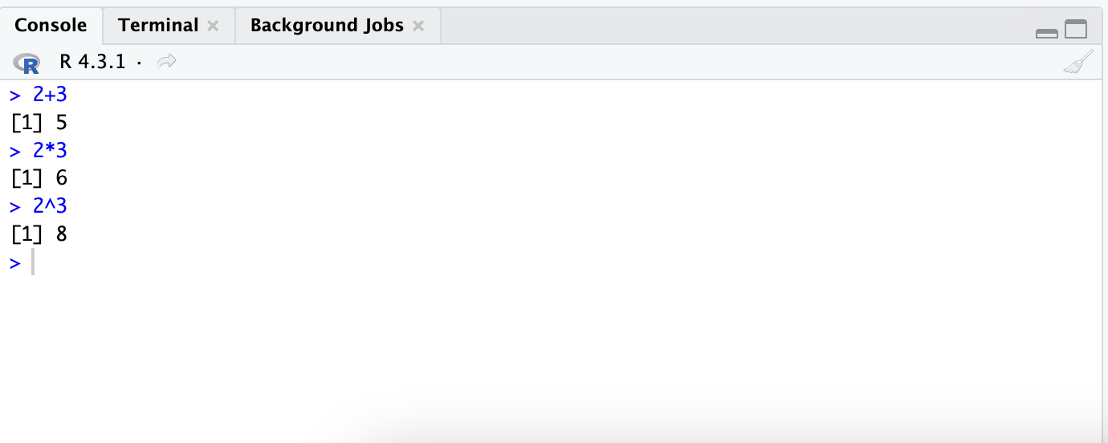
The results appear in the console pane.

Slide 41
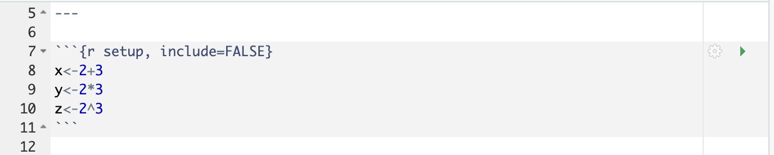
Assigning variable names

Slide 42
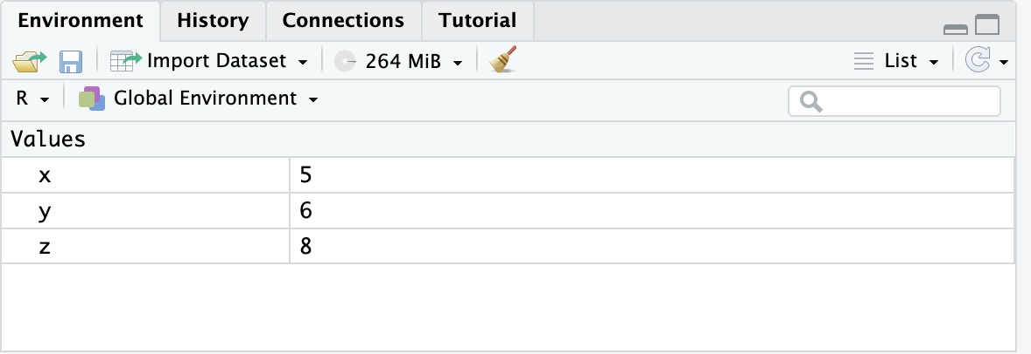
Assigning variable names

Slide 43
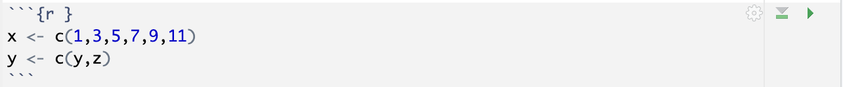

Slide 44
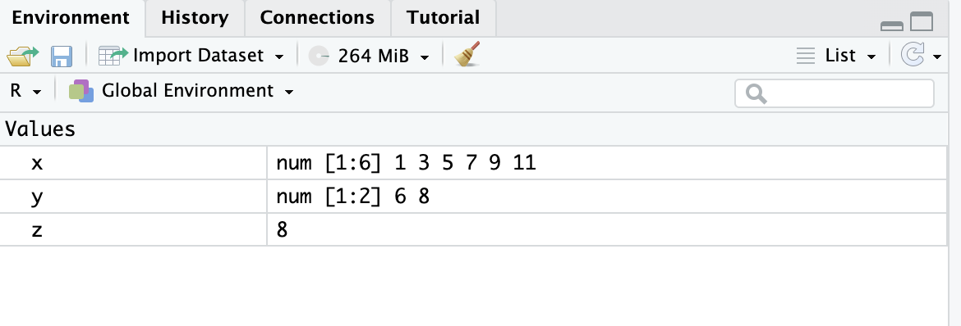

Slide 45
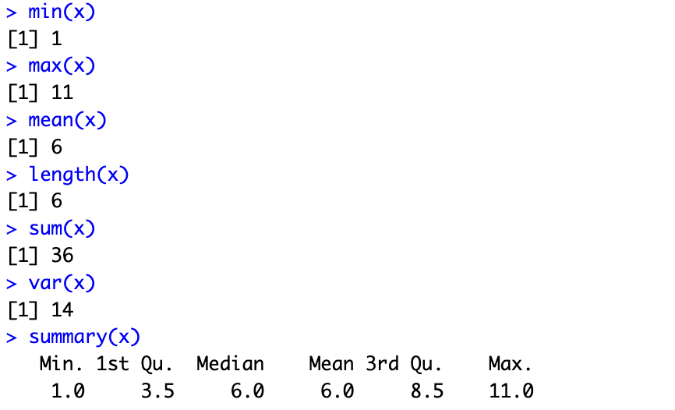
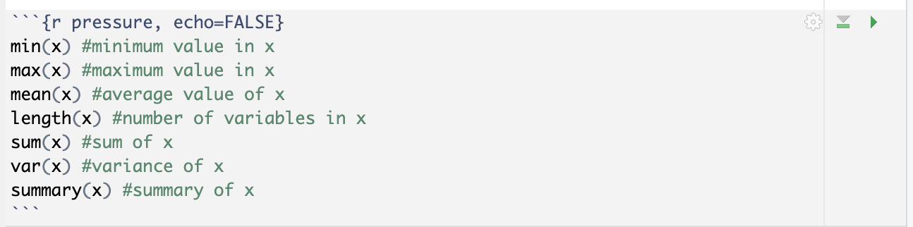

Slide 46
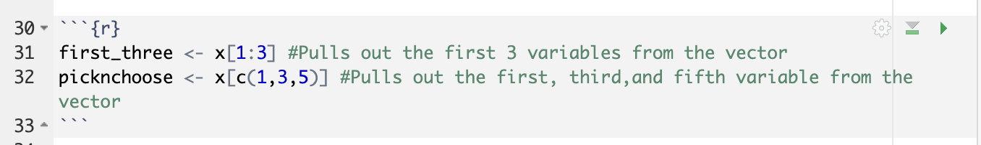
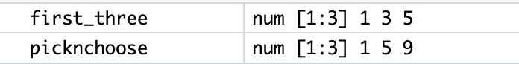
Pulling out parts of a dataset

Slide 47
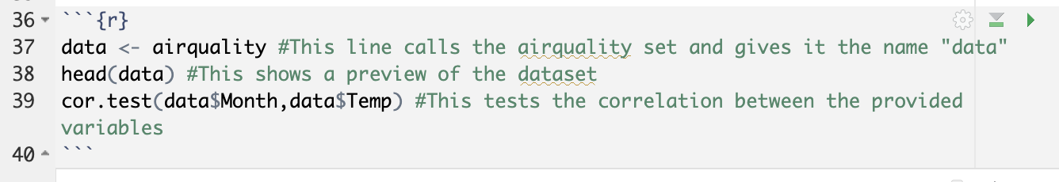

Slide 48
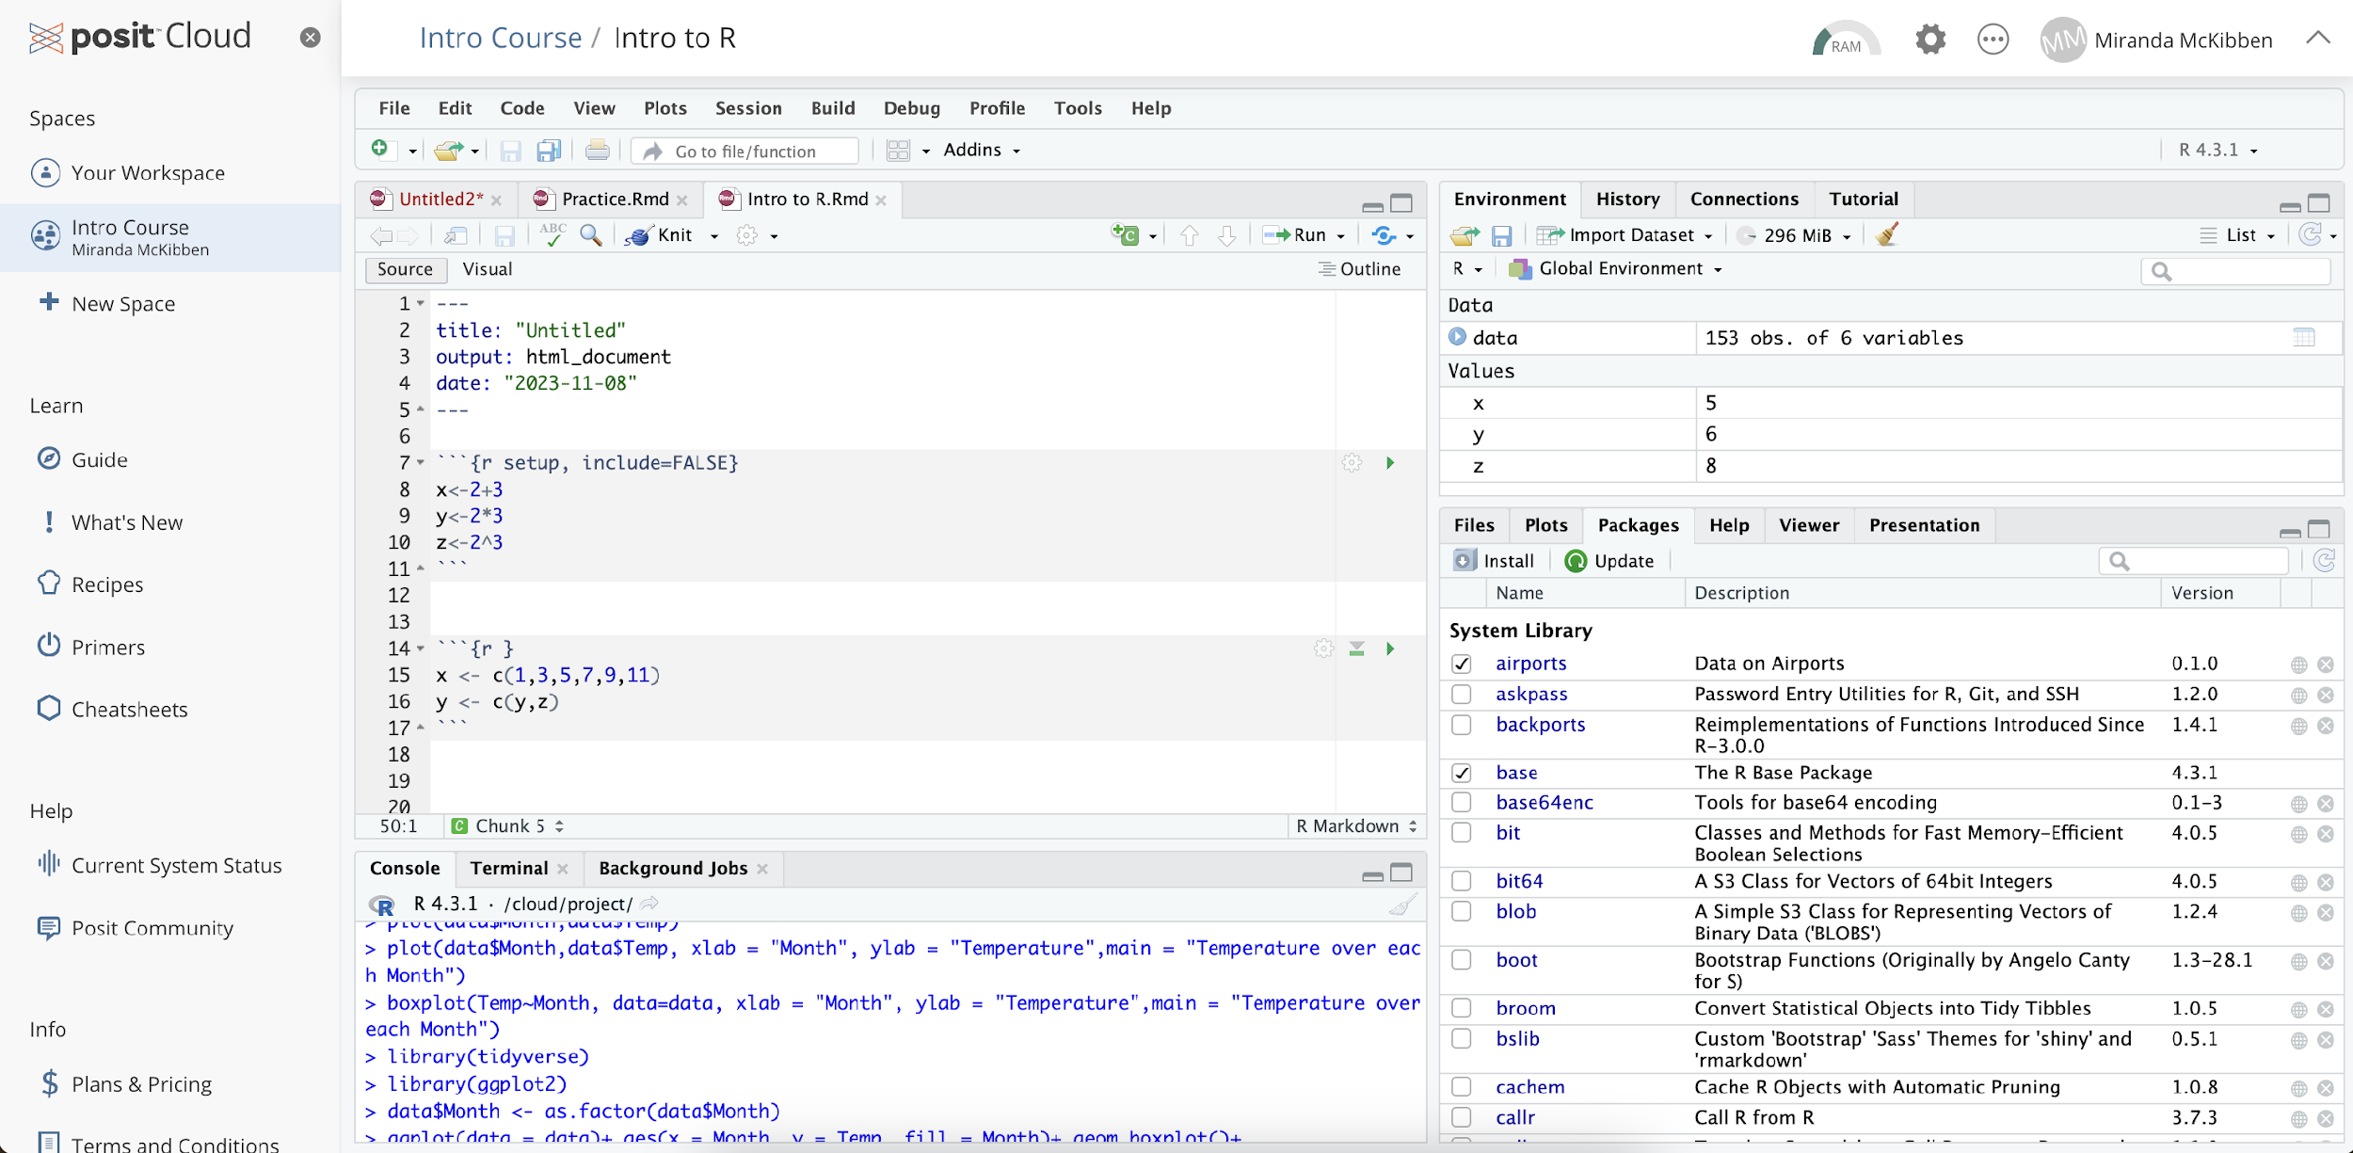

Slide 49
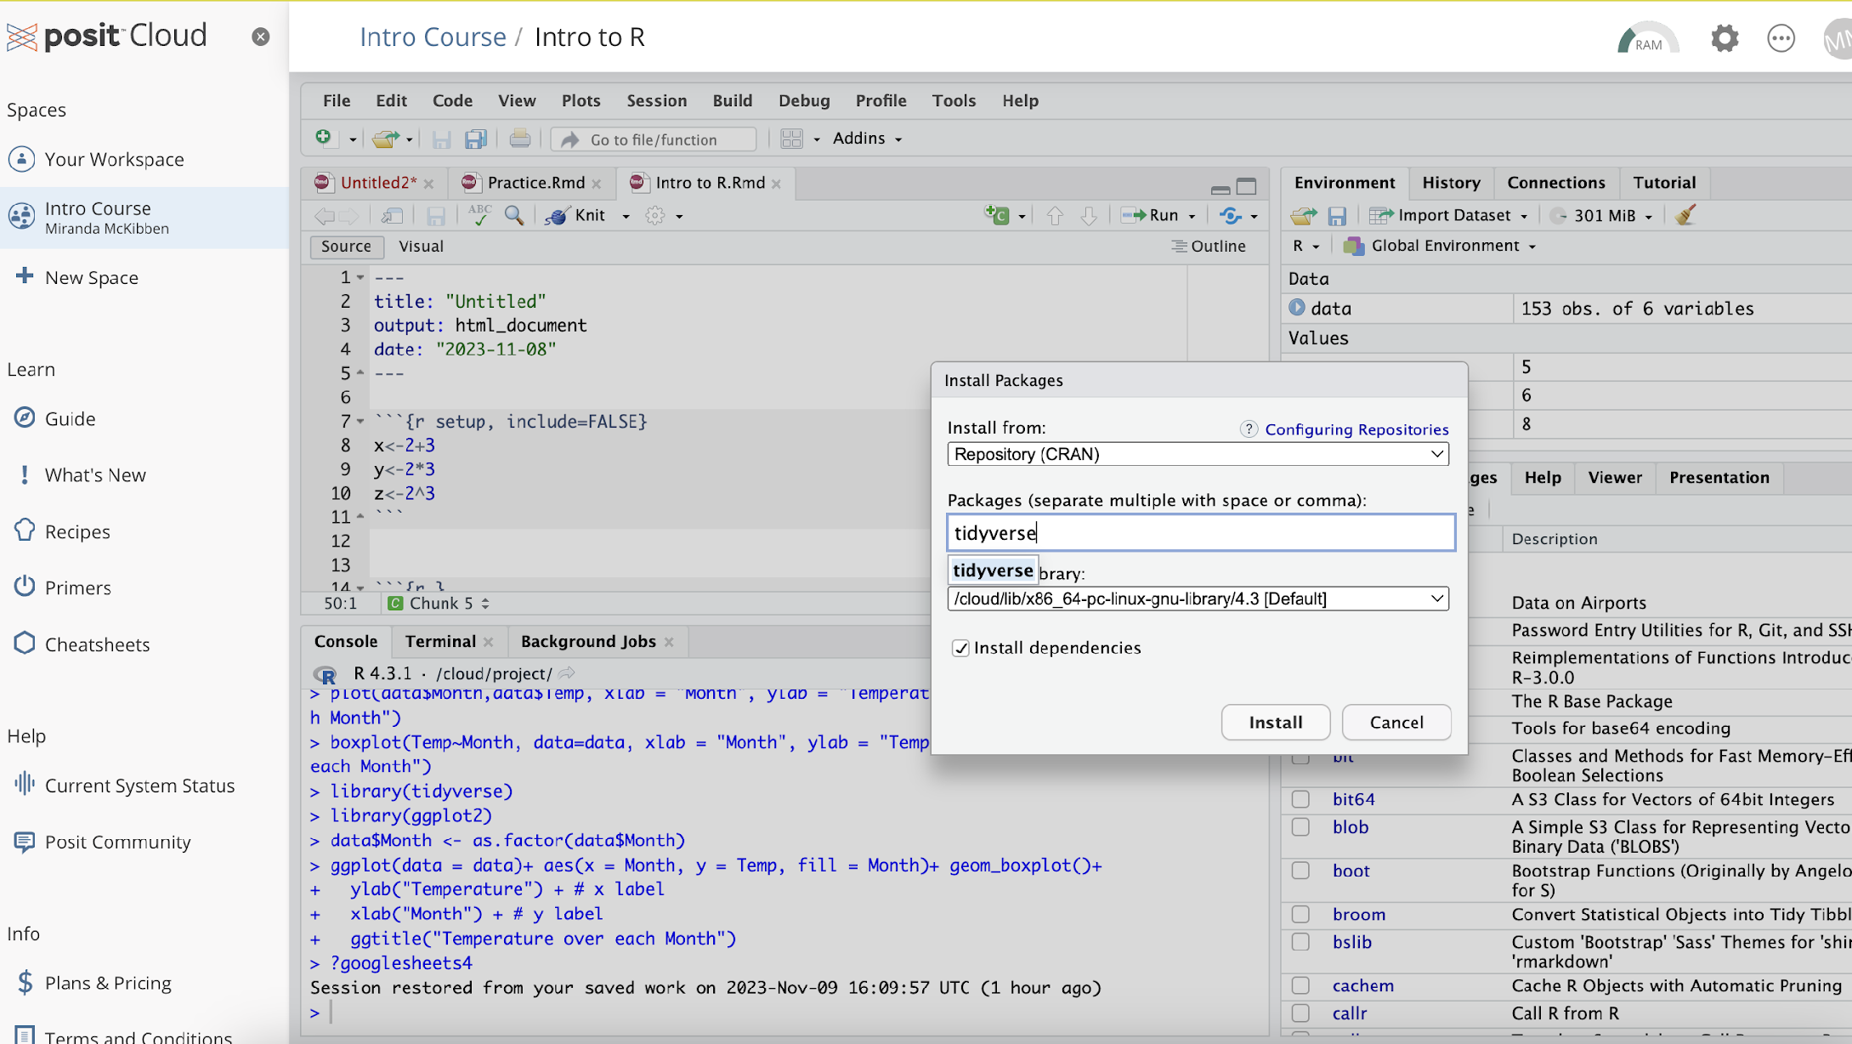

Slide 50
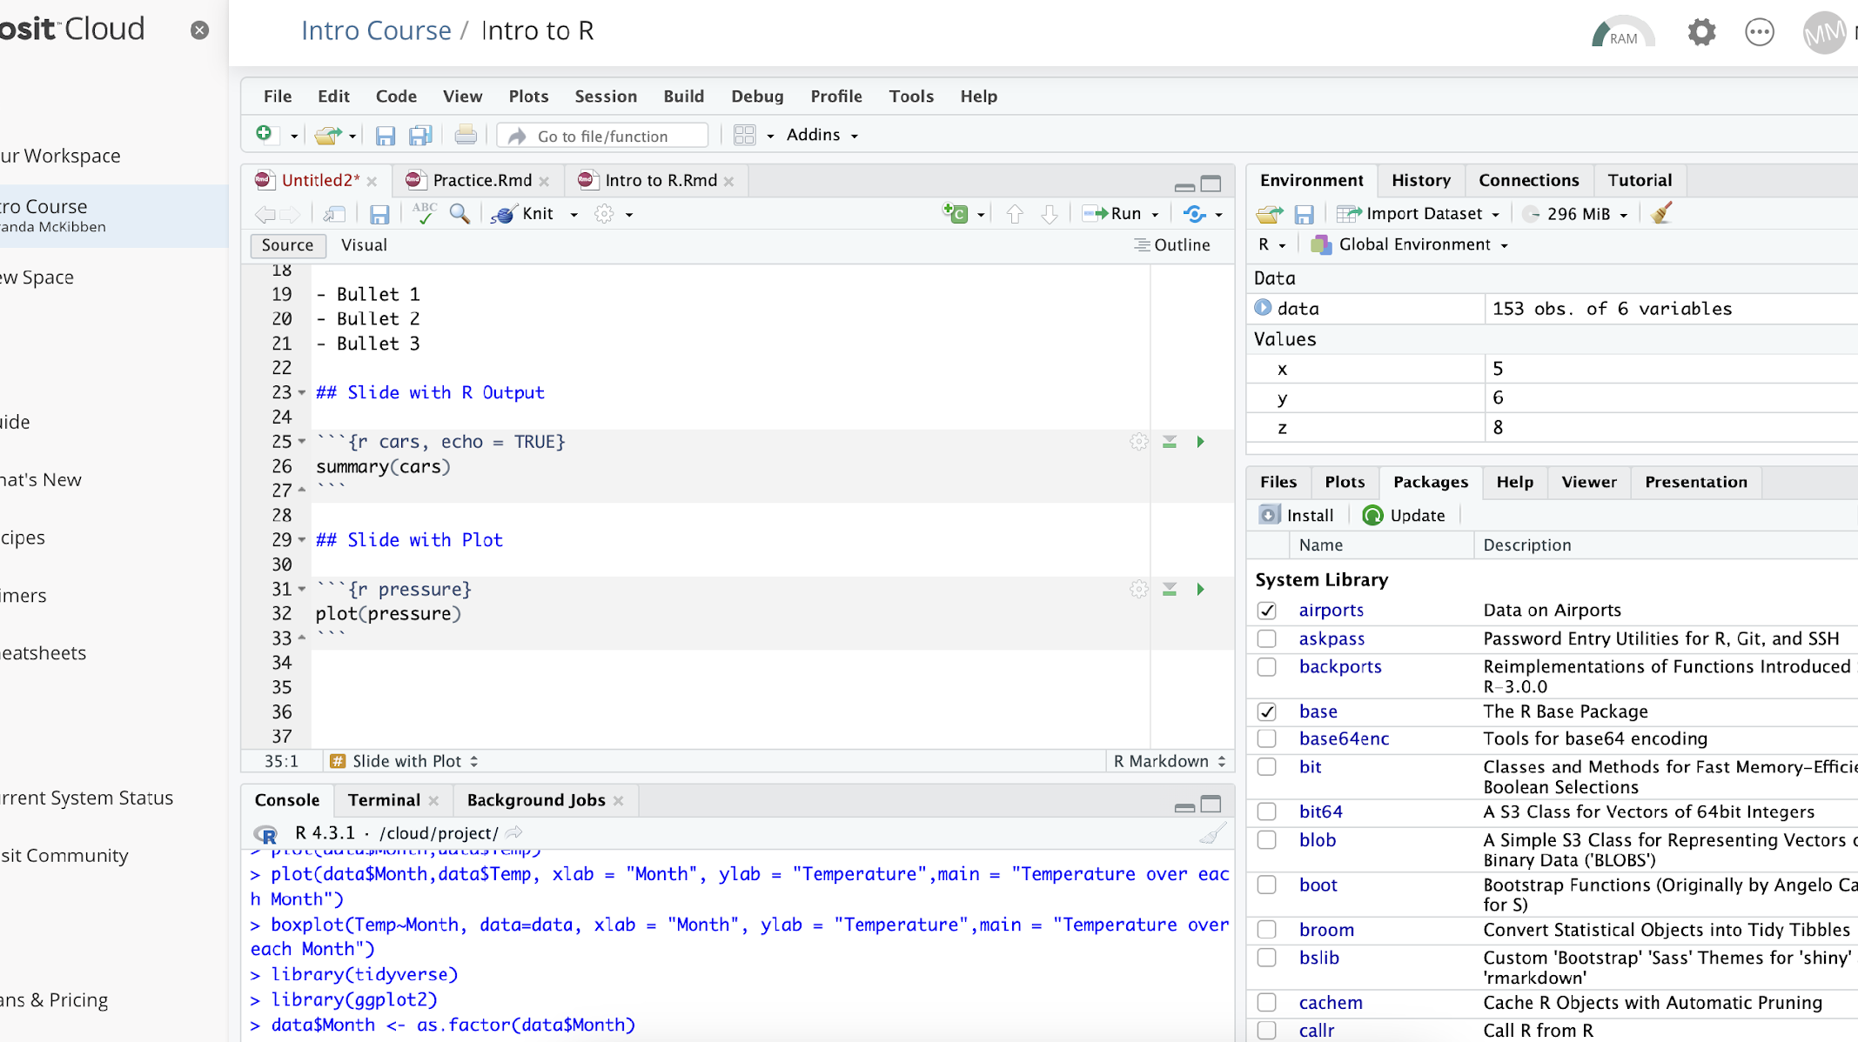

Slide 51
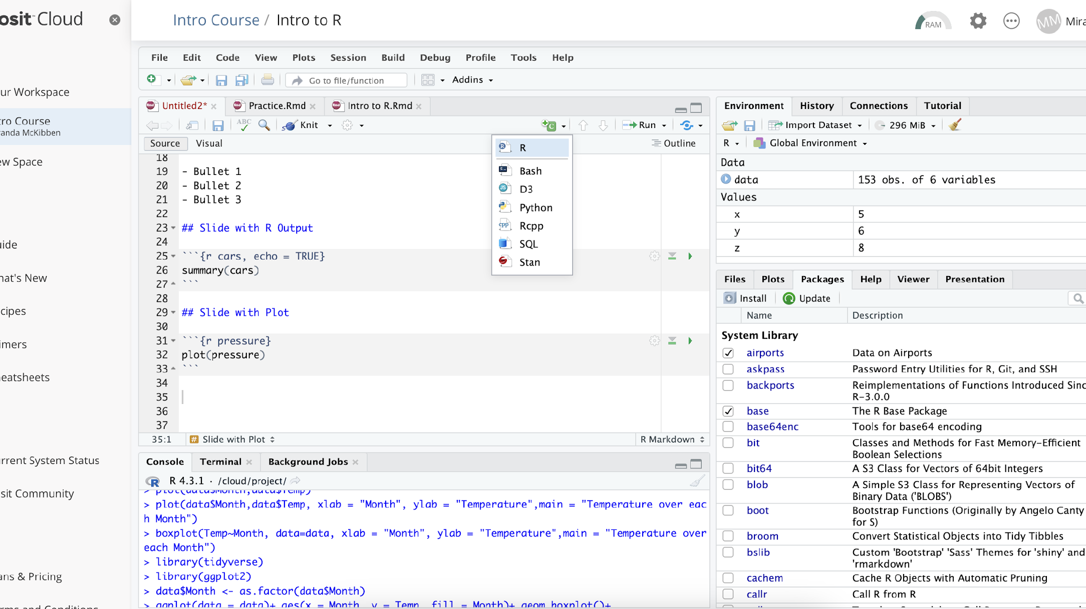

Slide 52
